Slide 1
Nix
Configure and Prosper
Notes:
JOHN HUGHES, MARY SHEERAN, LENNART AUGUSTSSON, STEVEN PROCTOR, MICHAŁ ŚLASKI

Slide 2

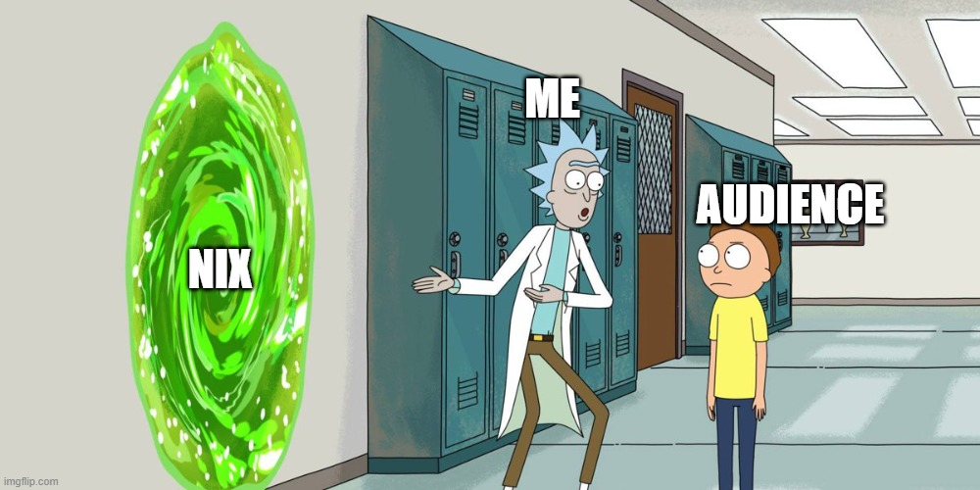
WHY?
Notes:
JOHN HUGHES, MARY SHEERAN, LENNART AUGUSTSSON, STEVEN PROCTOR, MICHAŁ ŚLASKI

Slide 3
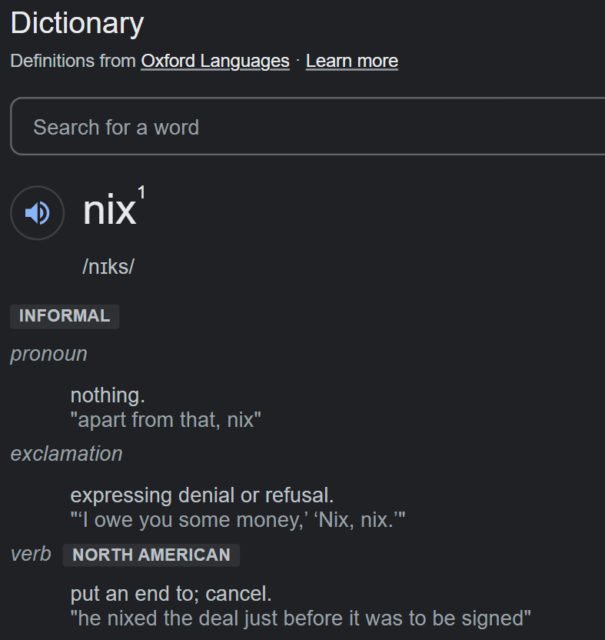
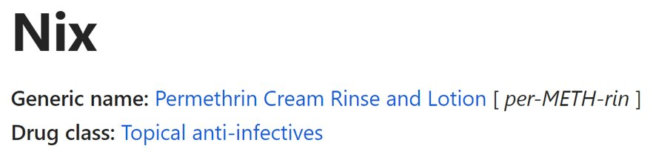
What is Nix?
Notes:
JOHN HUGHES, MARY SHEERAN, LENNART AUGUSTSSON, STEVEN PROCTOR, MICHAŁ ŚLASKI

Slide 4
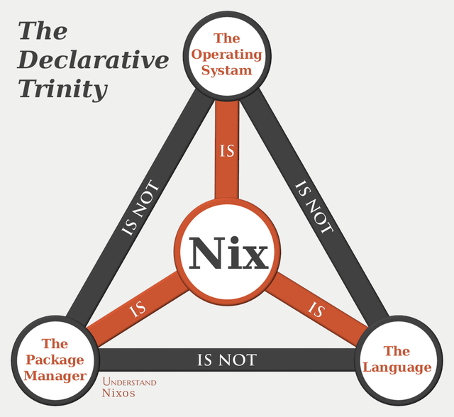
What is Nix?
Notes:
JOHN HUGHES, MARY SHEERAN, LENNART AUGUSTSSON, STEVEN PROCTOR, MICHAŁ ŚLASKI

Slide 5
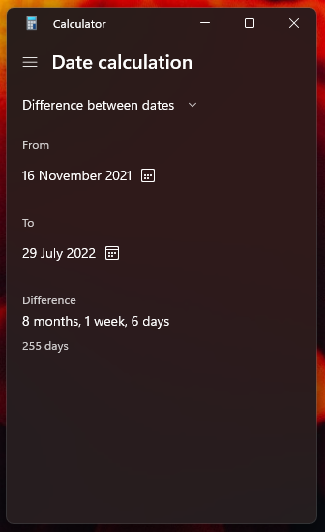
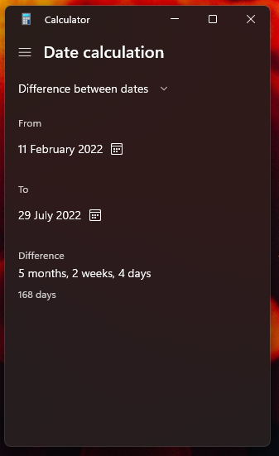
Story time!
Notes:
JOHN HUGHES, MARY SHEERAN, LENNART AUGUSTSSON, STEVEN PROCTOR, MICHAŁ ŚLASKI

Slide 6
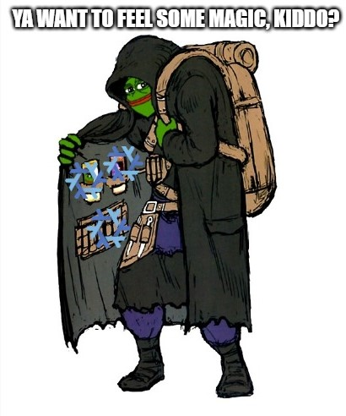
What does Nix 'ecosystem' offer?
Reproducibility
Immutability
Rollbacks
And our journey just begins...
Notes:
JOHN HUGHES, MARY SHEERAN, LENNART AUGUSTSSON, STEVEN PROCTOR, MICHAŁ ŚLASKI

Slide 7
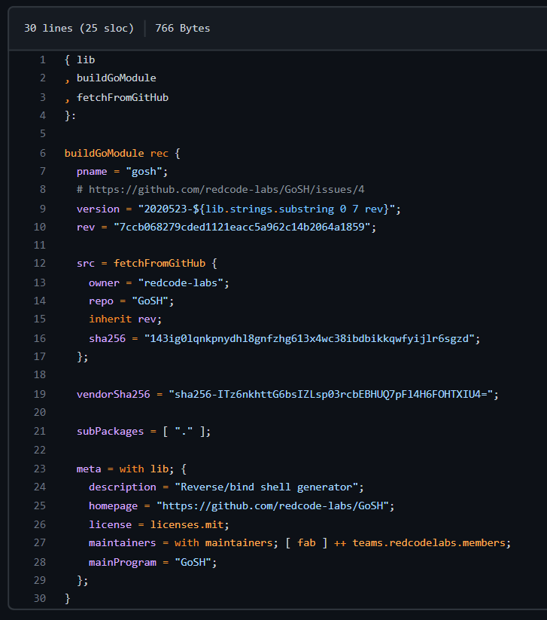
Nix as a language The true reason why the Tower of Babel was so messed up...
Notes:
JOHN HUGHES, MARY SHEERAN, LENNART AUGUSTSSON, STEVEN PROCTOR, MICHAŁ ŚLASKI

Slide 8
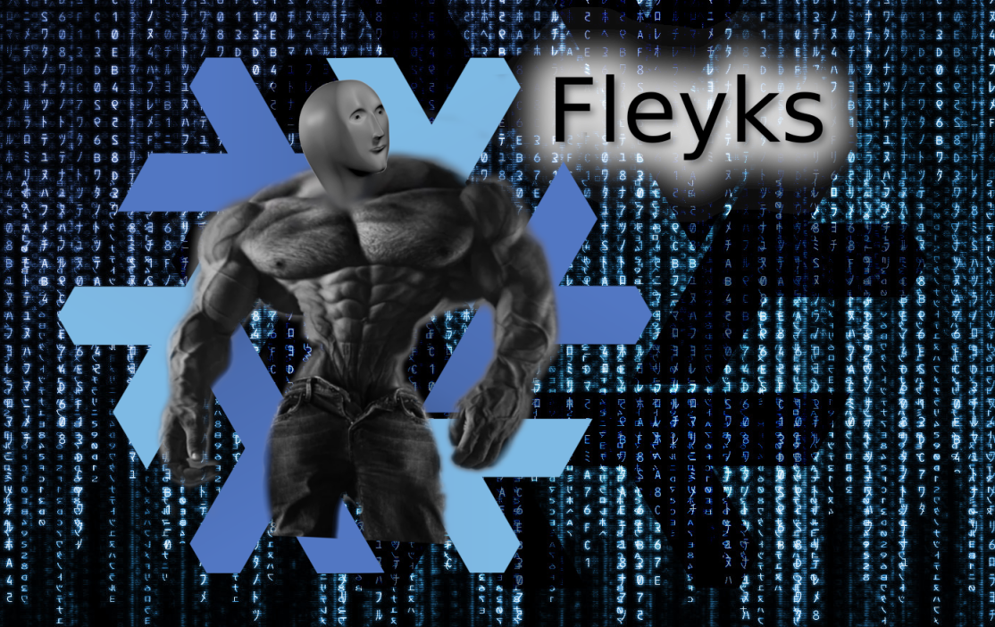
Flakes here comes that snowflake...
Quite advanced
More than powerful
Possibilities of Nix skyrocket thanks to them
Notes:
JOHN HUGHES, MARY SHEERAN, LENNART AUGUSTSSON, STEVEN PROCTOR, MICHAŁ ŚLASKI

Slide 9
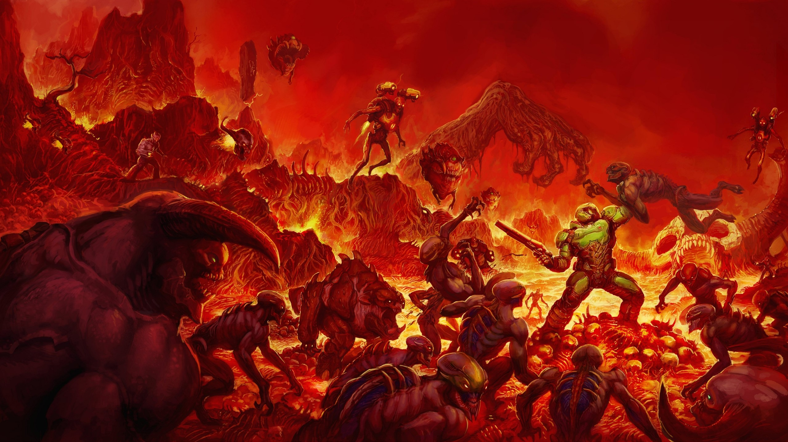

Nix as a package manager Doom Slayer in Dependency Hell
OOTB cross-compilation
OOTB static compilation
Easy to set up a binary cache
Source-based (hack on packages without forks)
Single package manager for different development environments
Notes:
JOHN HUGHES, MARY SHEERAN, LENNART AUGUSTSSON, STEVEN PROCTOR, MICHAŁ ŚLASKI

Slide 10
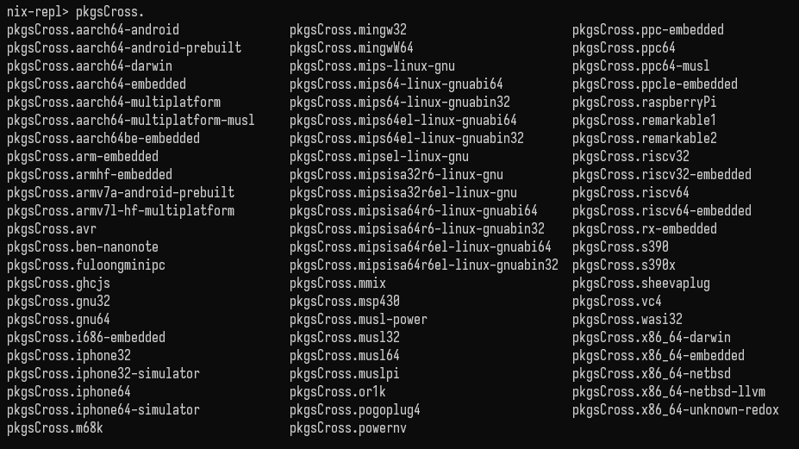
Nix as a package manager Doom Slayer in Dependency Hell
Notes:
JOHN HUGHES, MARY SHEERAN, LENNART AUGUSTSSON, STEVEN PROCTOR, MICHAŁ ŚLASKI

Slide 11
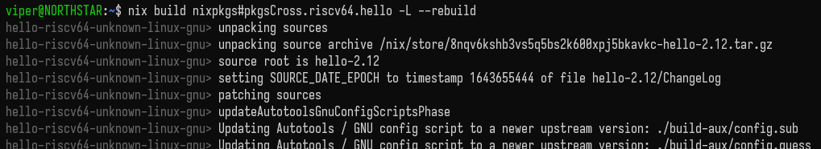
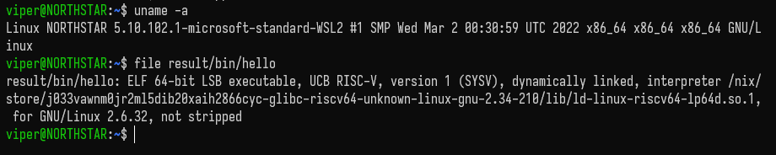
Nix as a package manager Doom Slayer in Dependency Hell
Notes:
JOHN HUGHES, MARY SHEERAN, LENNART AUGUSTSSON, STEVEN PROCTOR, MICHAŁ ŚLASKI

Slide 12
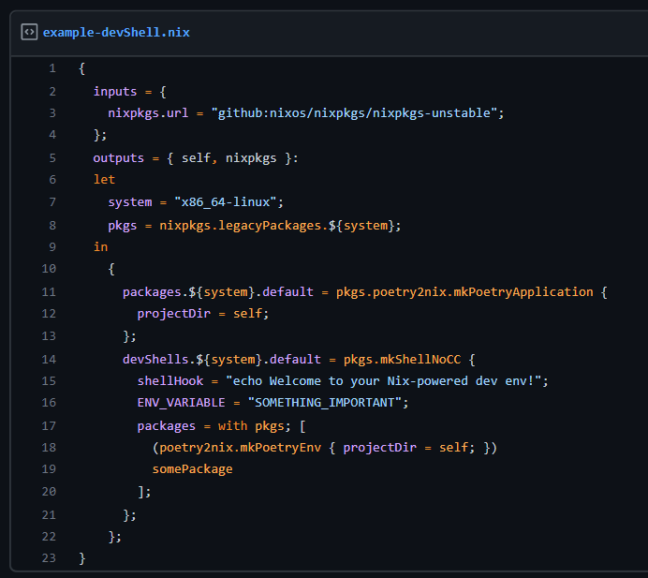
Nix as a package manager Doom Slayer in Dependency Hell
Notes:
JOHN HUGHES, MARY SHEERAN, LENNART AUGUSTSSON, STEVEN PROCTOR, MICHAŁ ŚLASKI

Slide 13
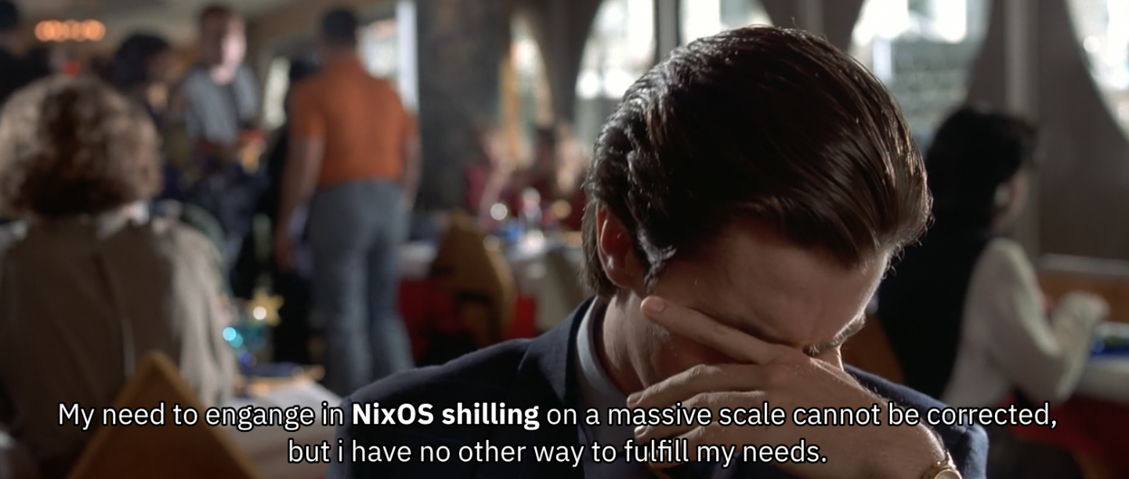
Nix as an OS Nix philosophy to the cor... umm...kernel
Notes:
JOHN HUGHES, MARY SHEERAN, LENNART AUGUSTSSON, STEVEN PROCTOR, MICHAŁ ŚLASKI

Slide 14
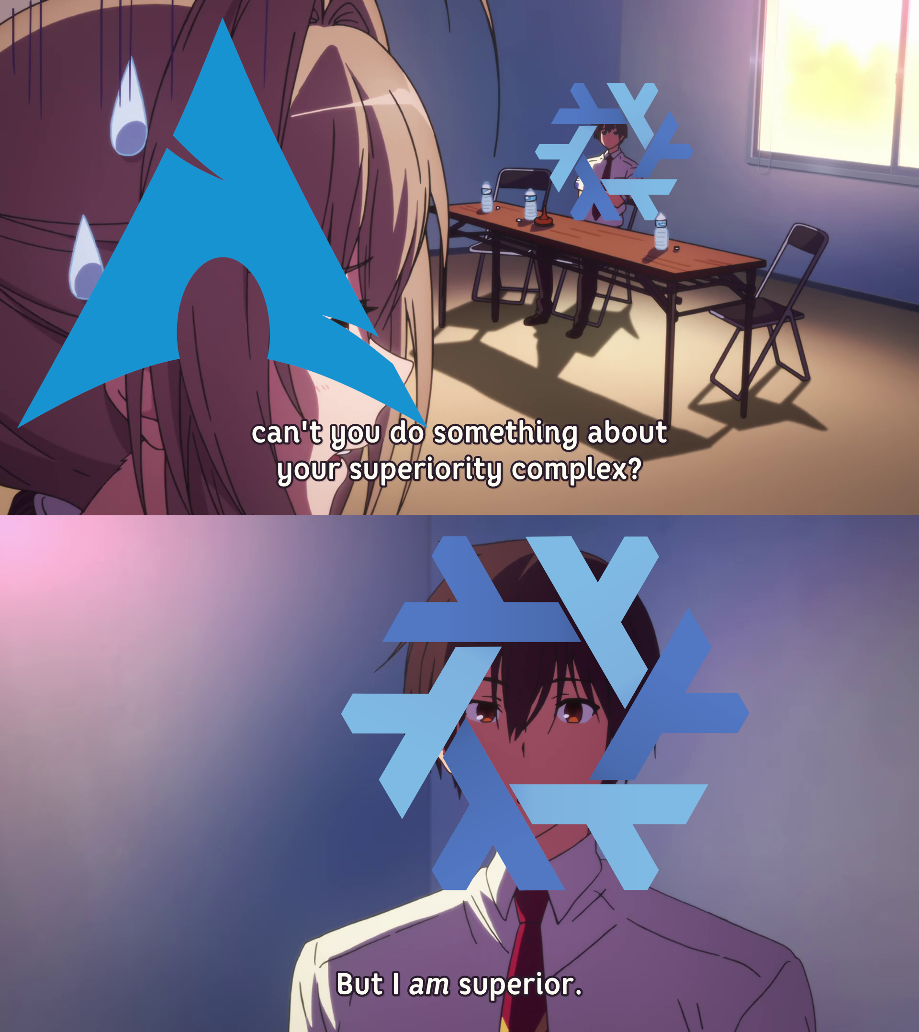
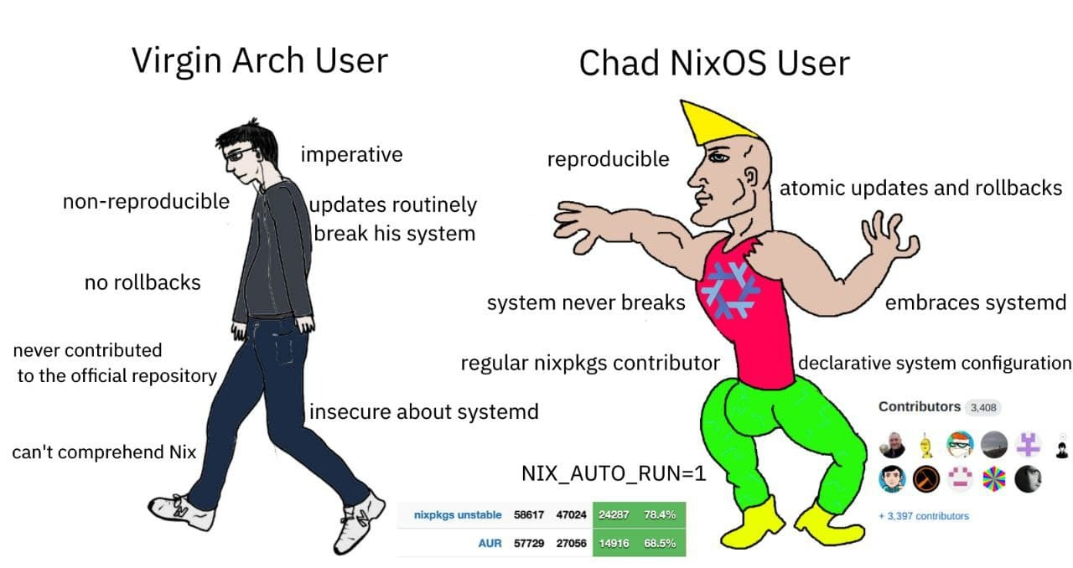
Nix as an OS Nix philosophy to the cor... umm...kernel
Notes:
JOHN HUGHES, MARY SHEERAN, LENNART AUGUSTSSON, STEVEN PROCTOR, MICHAŁ ŚLASKI

Slide 15
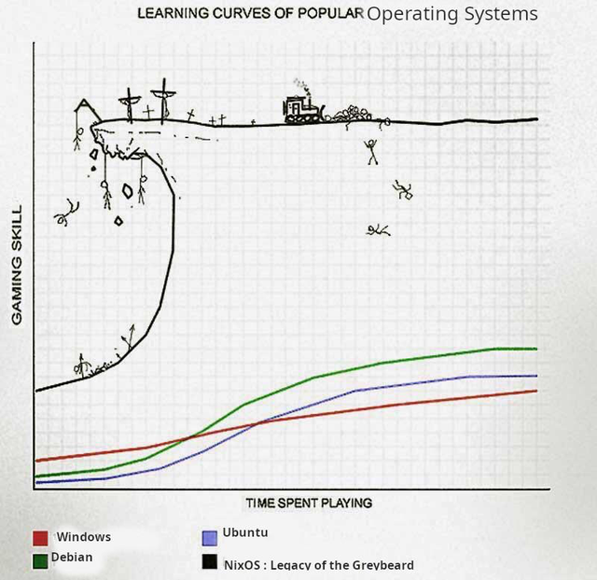
Nix as an OS Nix philosophy to the cor... umm...kernel
There are some cons as well but who cares, Nix is cool enough to omit all of those cons, but those are only:
Not every binary works OOTB (requires patchelf)
Quite slippery slope learning curve
The biggest part of 'Nix ecosystem', can combine EVERYTHING
Notes:
JOHN HUGHES, MARY SHEERAN, LENNART AUGUSTSSON, STEVEN PROCTOR, MICHAŁ ŚLASKI

Slide 16
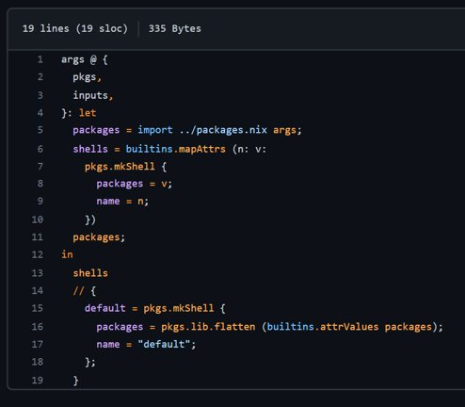
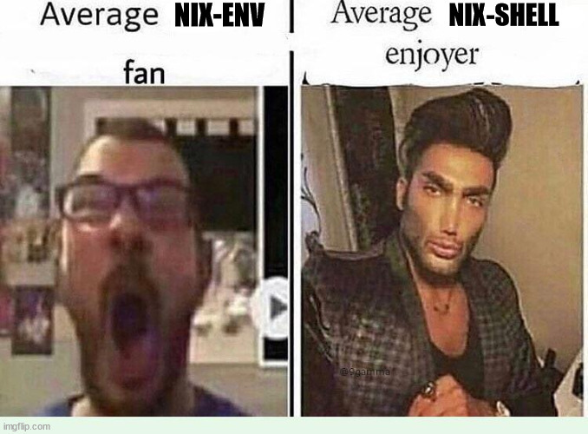
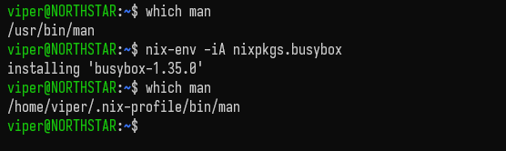
nix-shells rule 'em all!
Nix-env is a no-no!
Imperative (ew)
Can 'mask' your current 'system state'
Notes:
JOHN HUGHES, MARY SHEERAN, LENNART AUGUSTSSON, STEVEN PROCTOR, MICHAŁ ŚLASKI

Slide 17
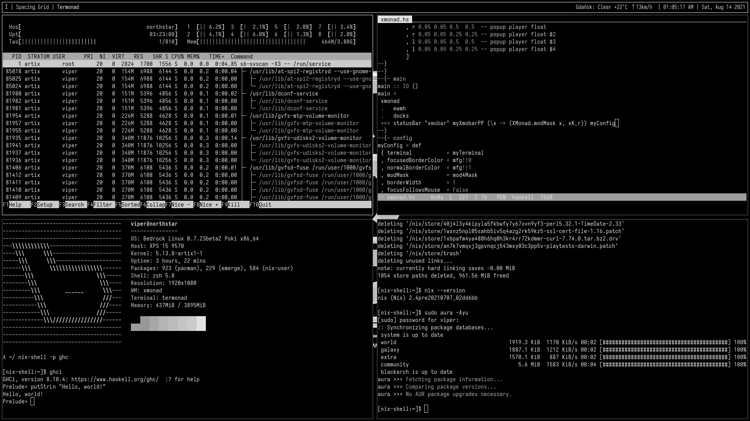
Non-NixOS Nix the nightmare just begins
Notes:
JOHN HUGHES, MARY SHEERAN, LENNART AUGUSTSSON, STEVEN PROCTOR, MICHAŁ ŚLASKI

Slide 18
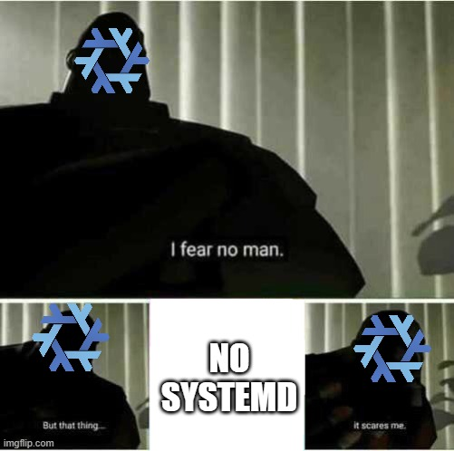
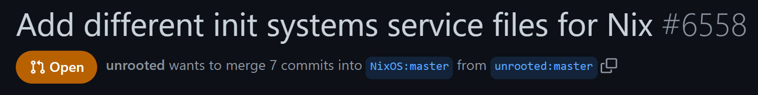
Non-NixOS Nix the nightmare just begins
Notes:
JOHN HUGHES, MARY SHEERAN, LENNART AUGUSTSSON, STEVEN PROCTOR, MICHAŁ ŚLASKI

Slide 19


Beyond Nix if you only knew, how good things really are
Notes:
JOHN HUGHES, MARY SHEERAN, LENNART AUGUSTSSON, STEVEN PROCTOR, MICHAŁ ŚLASKI

Slide 20
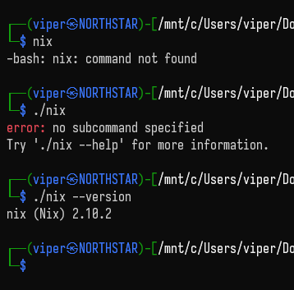
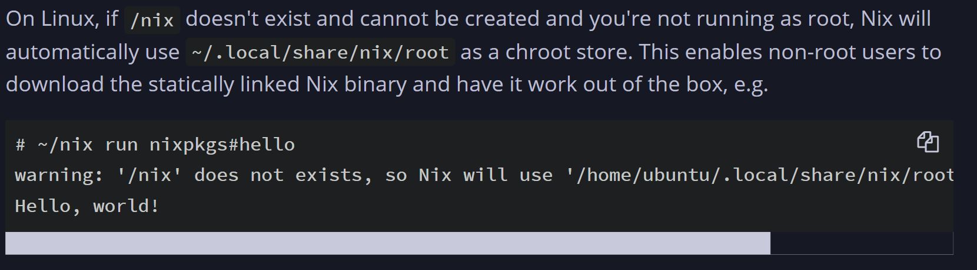
Nix portable (Nix 2.10.+) next-gen sidearm
Notes:
JOHN HUGHES, MARY SHEERAN, LENNART AUGUSTSSON, STEVEN PROCTOR, MICHAŁ ŚLASKI

Slide 21
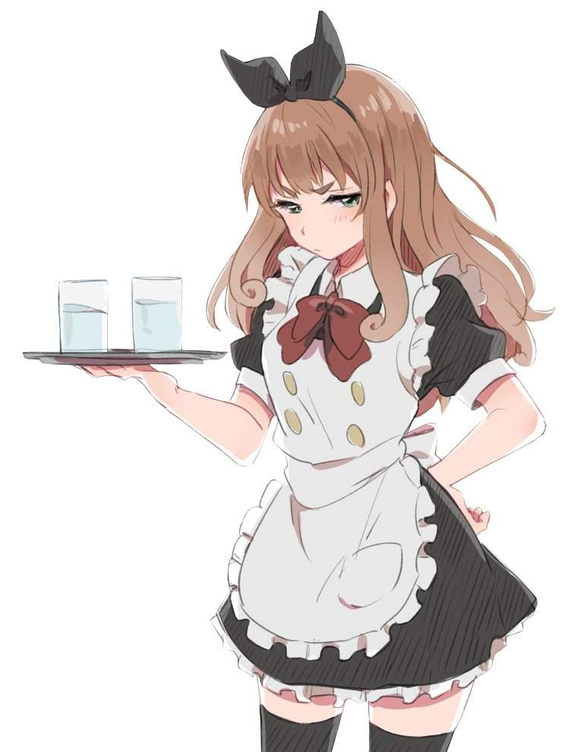
home-manager /home, sweet /home
Think of it as of a maid:
Manages your home
Keeps your home tidy
Notes:
JOHN HUGHES, MARY SHEERAN, LENNART AUGUSTSSON, STEVEN PROCTOR, MICHAŁ ŚLASKI

Slide 22
TL;DR?
1. Reproducible - produces exactly the same build every time. 2. Unless early boot is broken, boots to a consistent state. 3. Can easily rollback to the previous system configuration state. 4. Declarative config FOR EVERYTHING! 5. Integration with a whole bunch of packages. Your beloved GUI rices included. 6. Cloud integration. Brilliant Docker images, also magic like NixOps 7. Portability - Nix runs on Linux and macOS, and takes 5 minutes to install (clone config and you're done). 8. Free of side effects - Actually uninstalls packages and its dependencies 9. Bleeding and stable - Can run multiple versions of the package without conflicts 10. Implicit containerization - Lorri and direnv make switching between project-local tooling easy. 11. Virtual Machines - VFIO is EASY to set up and perform declaratively (much more so than arch). 12. Kernel hacking - Kernel flags and patches are easy to add to config. 13. Use flags + source-based - each package has overrides to allow (or disallow) features to be built. Makes for a lean mean machine. Binary caching for speed. 14. OOTB rollbacks
Notes:
JOHN HUGHES, MARY SHEERAN, LENNART AUGUSTSSON, STEVEN PROCTOR, MICHAŁ ŚLASKI

Slide 23
TL;DR?
- Focus on correctness - Reliable package storage structure - Results are read-only - OOTB cross-compilation support - OOTB static compilation support - Source-based (you can alter packages build without forking anything) - Single package manager to rule them all! (c, python, docker, nodejs, etc) - Great for development environment, will take care of all dependencies no matter if its postgresql or glibc - Easy to set up a binary cache - By default has a binary cache so you almost never need to compile anything - Easy to set up build farm - Super convenient for CI/CD - Excellent testing infrastructure - More often than not build results are bit per bit reproducible
Notes:
JOHN HUGHES, MARY SHEERAN, LENNART AUGUSTSSON, STEVEN PROCTOR, MICHAŁ ŚLASKI

Slide 24
What is Nix?
Notes:
JOHN HUGHES, MARY SHEERAN, LENNART AUGUSTSSON, STEVEN PROCTOR, MICHAŁ ŚLASKI

Slide 25
References
NixOS - NixOS Linux
NixOS - Nixpkgs 22.11 manual
NixOS - Nix Pills
Nix community projects (github.com)
gytis-ivaskevicius/high-quality-nix-content: GitHub repository containing highest quality Nix/NixOS content
Notes:
JOHN HUGHES, MARY SHEERAN, LENNART AUGUSTSSON, STEVEN PROCTOR, MICHAŁ ŚLASKI

Slide 26

Special thanks to...

Slide 27

Notes:
JOHN HUGHES, MARY SHEERAN, LENNART AUGUSTSSON, STEVEN PROCTOR, MICHAŁ ŚLASKI

Slide 28
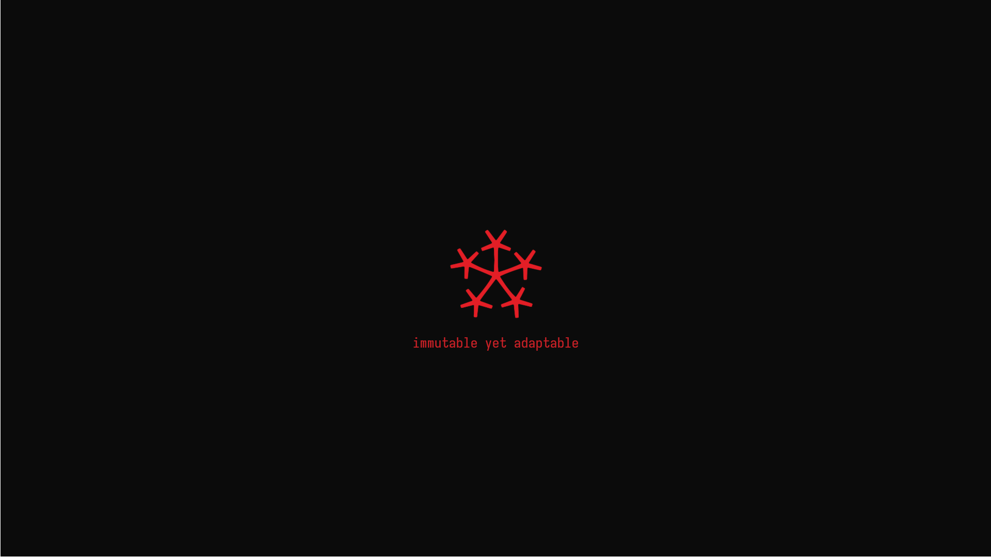

RedNixOS
Notes:
JOHN HUGHES, MARY SHEERAN, LENNART AUGUSTSSON, STEVEN PROCTOR, MICHAŁ ŚLASKI

Slide 29
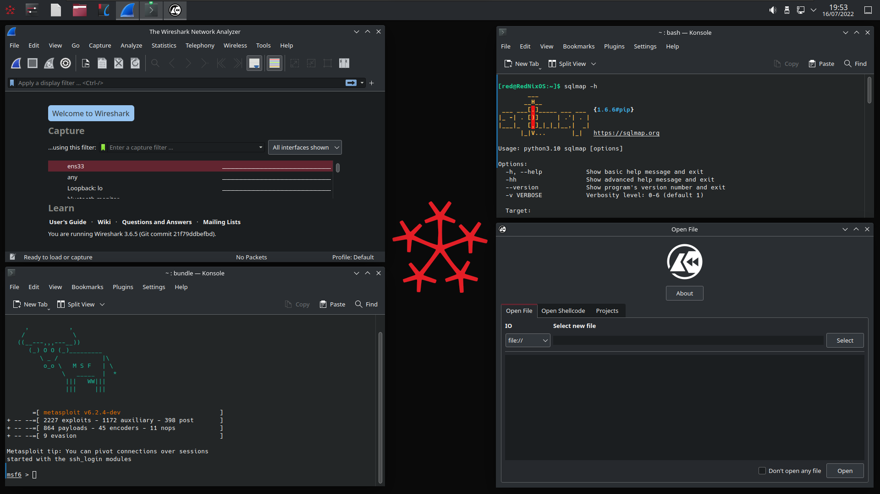
RedNixOS
Notes:
JOHN HUGHES, MARY SHEERAN, LENNART AUGUSTSSON, STEVEN PROCTOR, MICHAŁ ŚLASKI

Slide 30
Q&A

Slide 31
Thanks!

